Slide 1


Project Topic: Civil Societies

Slide 2

NGIAtlantic.eu
NGIAtlantic.eu - A Collaborative platform for EU-US NGI experiments
Benefit to society (Image/Graph)
NGI is developing an Internet of Humans.
The projects funds experiments in topics that respond to people’s fundamental needs, including trust, security, and inclusion, while reflecting the values and the norms all citizens enjoy in Europe.
Strategic Programme Office
Civil Societies
james.clarke@waltoninstitute.ie
Funding Agency: Horizon2020
Key Facts from EC participant portal:
What call? H2020-ICT-2019-2
Partners:
SETU
TRUST-IT
Amount: €3,499,937.50
Amount to WIT: €3,087,750.00
Figure caption

Slide 3
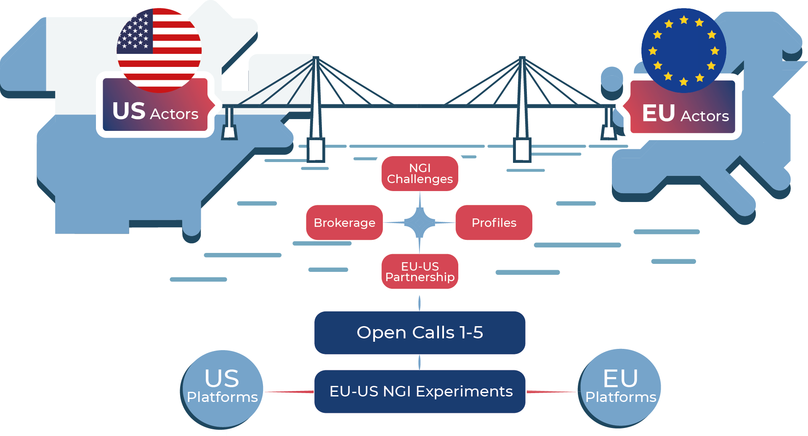
NGIAtlantic.eu
Strategic Programme Office
Future of the Internet
james.clarke@waltoninstitute.ie
Research Challenge:
-
-
-
State-of-the-Art & Limitations:
Funding experiments between EU and USA partners.
Lack of funding for USA partners, but this is mitigated with a NSF based fund for NSF grant holders who are in winning proposals.
Overview of project concept

Slide 4
NGIAtlantic.eu
Figure illustrating the proposed approach/novelty
Strategic Programme Office
Future of the Internet
james.clarke@waltoninstitute.ie
Novel Approach:
NGIatlantic.eu will develop, manage and publicise an organisational and financial funding platform to the end user.
It will create an efficient process for regular research cycles of cascade funded projects engagements between EU and US innovators.
Impact (& Links to other projects?):
The project is related to common priority topics from within the EU’s NGI related Experimental Platforms, including FIRE, 5G-PPP, and the US’s relevant Internet programmes, including The NSF’s wired funded programmes, ENTeR / GENI and Future Cloud Platform.
Figure caption

Slide 5
NGIAtlantic.eu
Graphs from publications
Strategic Programme Office
Future of the Internet
James.clarke@waltoninstitute.ie
Key Results:
Attract and enable start-ups and innovators from EU and US to collaborate together on experimental platforms through Open call cascade funded projects related to the NGI topics.
Establish an EU-US Twinning Lab and provision of necessary support services.
Setting up a transatlantic experimental platform “playground” that will reinforce collaboration and increase synergies between the EU’s Next Generation Internet initiative and the US’s Internet programmes and facilitate the development interoperable solutions and joint demonstrators.
To ensure maximum impact and sustainability of the transatlantic NGI activities.
Links to publications:
-
-
-
Figure caption

Slide 6
FirstName LastName
Email@Email.com

