Slide 1
Project Topic: Future Health

Slide 2
FAITH
a Federated Artificial Intelligence solution for moniToring mental Health status after cancer treatment
FAITH is an EU-funded research project aiming to provide an Artificial Intelligence based solution that remotely identifies depression markers in people that have undergone cancer treatment.
The main goal of the FAITH project is to develop a better model for mental health monitoring after treatment for cancer patients to improve their quality of life and aftercare, applying the latest advances in Artificial Intelligence & Machine Learning data analytical techniques.
Research Theme & Division:
HealthTech - MEPS division
gary.mcmanus@waltoninstitute.ie
Funding Agency: European Commission
Societal Challenges - Health, demographic change and well-being
Funding Call: H2020-SC1-DTH-2019
Start: 01/01/2020
End: 30/06/2023
Amount: €1,831,233
Amount to WIT: €1,007,625

Slide 3
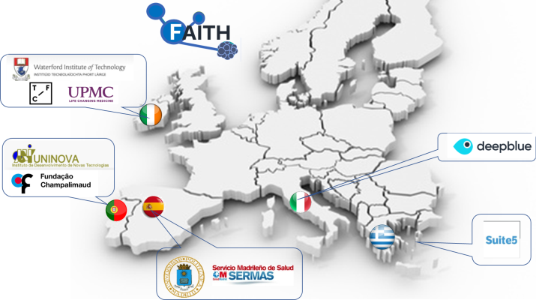
FAITH
Partners
Coordinator
WIT (Ireland)
Cancer Hospitals
Champalimaud (Portugal)
SERMAS (Spain)
UPMC (Ireland)
Technology and Data experts
WIT (Ireland)
UNINOVA (Portugal)
Universidad Politécnica de Madrid (Spain)
SMEs
Deep Blue (Italy)
Suite5 Data Intelligence Solutions (Cyprus)
TFC Research and Innovation Limited (Ireland)
Research Theme & Division:
HealthTech - MEPS division
gary.mcmanus@waltoninstitute.ie
Funding Agency: European Commission
Societal Challenges - Health, demographic change and well-being
Funding Call: H2020-SC1-DTH-2019
Start: 01/01/2020
End: 30/06/2023
Amount: €1,831,233
Amount to WIT: €1,007,625

Slide 4
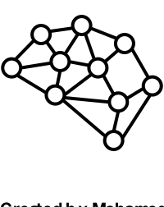
FAITH
Research Theme & Division:
HealthTech - MEPS division
gary.mcmanus@waltoninstitute.ie
Central Unit / Cloud
Sleep Quality
Activity Profile
Outlook Profile
Nutrition Profile
Research Challenge:
To predict negative trends in the mental health of cancer patients that have undergone therapy, and to achieve this through the integration of AI without compromising on privacy of patient’s data
Project Challenges:
Identifying the right indicators
Tackling privacy issues
AI Trust
Engaging Users
Traditional Centralized AI Models
move data to “central unit”
Patient
FAITH App
Medical personnel

Slide 5
FAITH
Research Theme & Division:
HealthTech - MEPS division
gary.mcmanus@waltoninstitute.ie
Central Unit / Cloud
FAITH uses a Federated Learning approach to move AI analytics to local device
Research Challenge:
To predict negative trends in the mental health of cancer patients that have undergone therapy, and to achieve this through the integration of AI without compromising on privacy of patient’s data
Project Challenges:
Identifying the right indicators
Tackling privacy issues
AI Trust
Engaging Users
Patient
FAITH App
Local AI
Sleep Quality
Activity Profile
Outlook Profile
Nutrition Profile

Slide 6
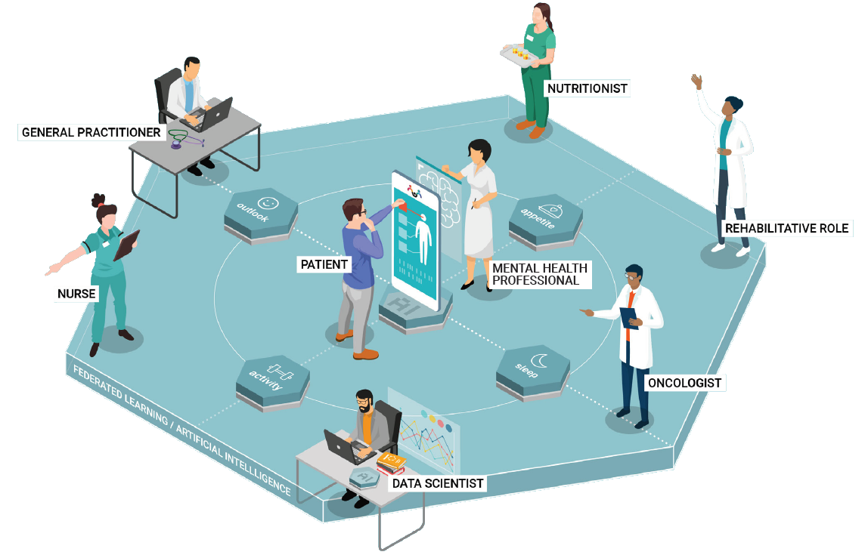
FAITH
Research Theme & Division:
HealthTech - MEPS division
gary.mcmanus@waltoninstitute.ie
Novel Approach:
Federated Learning
AI Predictive Modelling for depression
Analysis of Depression biomarkers
End User Validation
Impact (& Links to other projects?):
Increased Awareness of mental status in cancer survivors
Clustering of all projects in the call
Better Practice Guide
Participation in OPEN DEI Health Group

