Slide 1
Project Topic: Precision Agriculture

Slide 2
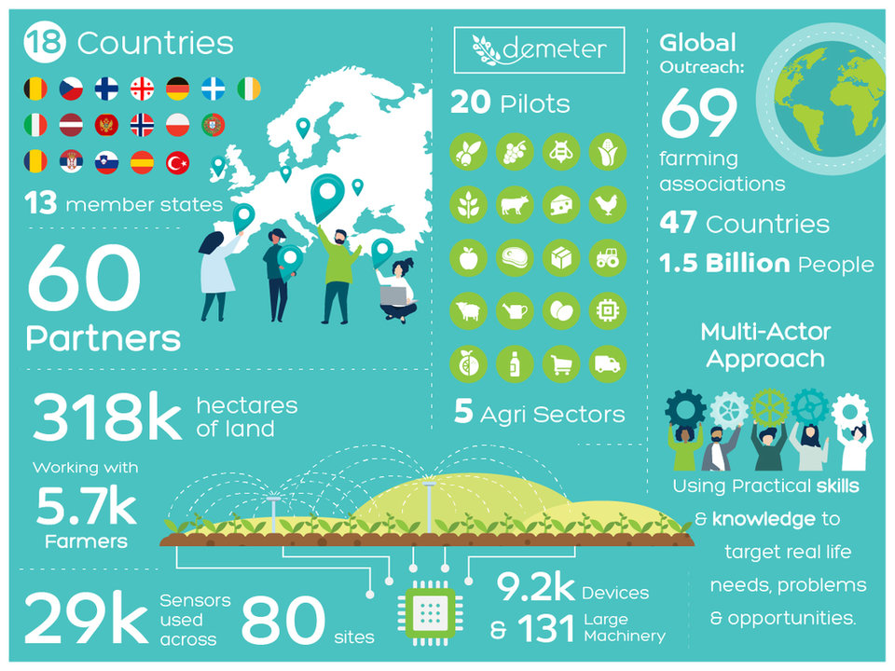
DEMETER
Precision Agriculture
Kevin.doolin@waltoninstitute.ie
Funding Agency: H2020
Key Facts from EC participant portal:
What call?
Key Partners (WP Leads):
Walton Institute, SETU
Amount: € 14 million
Amount to SETU:
Snapshot of DEMETER throughout Europe

Slide 3
DEMETER
Figure illustrating the problem
Precision Agriculture
Kevin.doolin@waltoninstitute.ie
Research Challenge:
-
-
-
State-of-the-Art & Limitations:
-
-
-
-
Figure caption

Slide 4
DEMETER
Figure illustrating the proposed approach/novelty
Precision Agriculture
Kevin.doolin@waltoninstitute.ie
Novel Approach:
Project activities are deployed by means of seven core work packages, for inter-related areas, selected to cover areas of major significance to the agriculture and food sector, and concurrently deliver multi-actor involvement
Twenty pilot projects are running across 18 European countries and a wide spectrum of sub-sectors: arable crops, irrigated crops, fruit and vegetable production, livestock (poultry, dairy, animal welfare) and the supply chain.
The pilots are used to demonstrate and evaluate how innovations and extended capabilities benefit from the interoperability mechanisms.
Impact (& Links to other projects?):
-
-
-
-
Figure caption

Slide 5
DEMETER
Graphs from publications
Precision Agriculture
Kevin.doolin@waltoninstitute.ie
Key Results:
Demonstrate the impact of digital innovations across a variety of sectors and at European level.
Analyse, adopt, enhance existing Information Models in the agri-food sector easing data sharing and interoperability across multiple Internet of Things (IOT) and Farming Management Information Systems (FMIS) and associated technologies.
Empower the farmer, as a prosumer, to gain control in the data-food-chain by identifying and demonstrating a series of new IoT-based, data-driven, business models for profit, collaboration and co-production for farmers and across the value chain, leading to disruptive new value creation models.
Links to publications:
-
-
-
-
Figure caption

Slide 6
FirstName LastName
Email@Email.com

